Slide 1
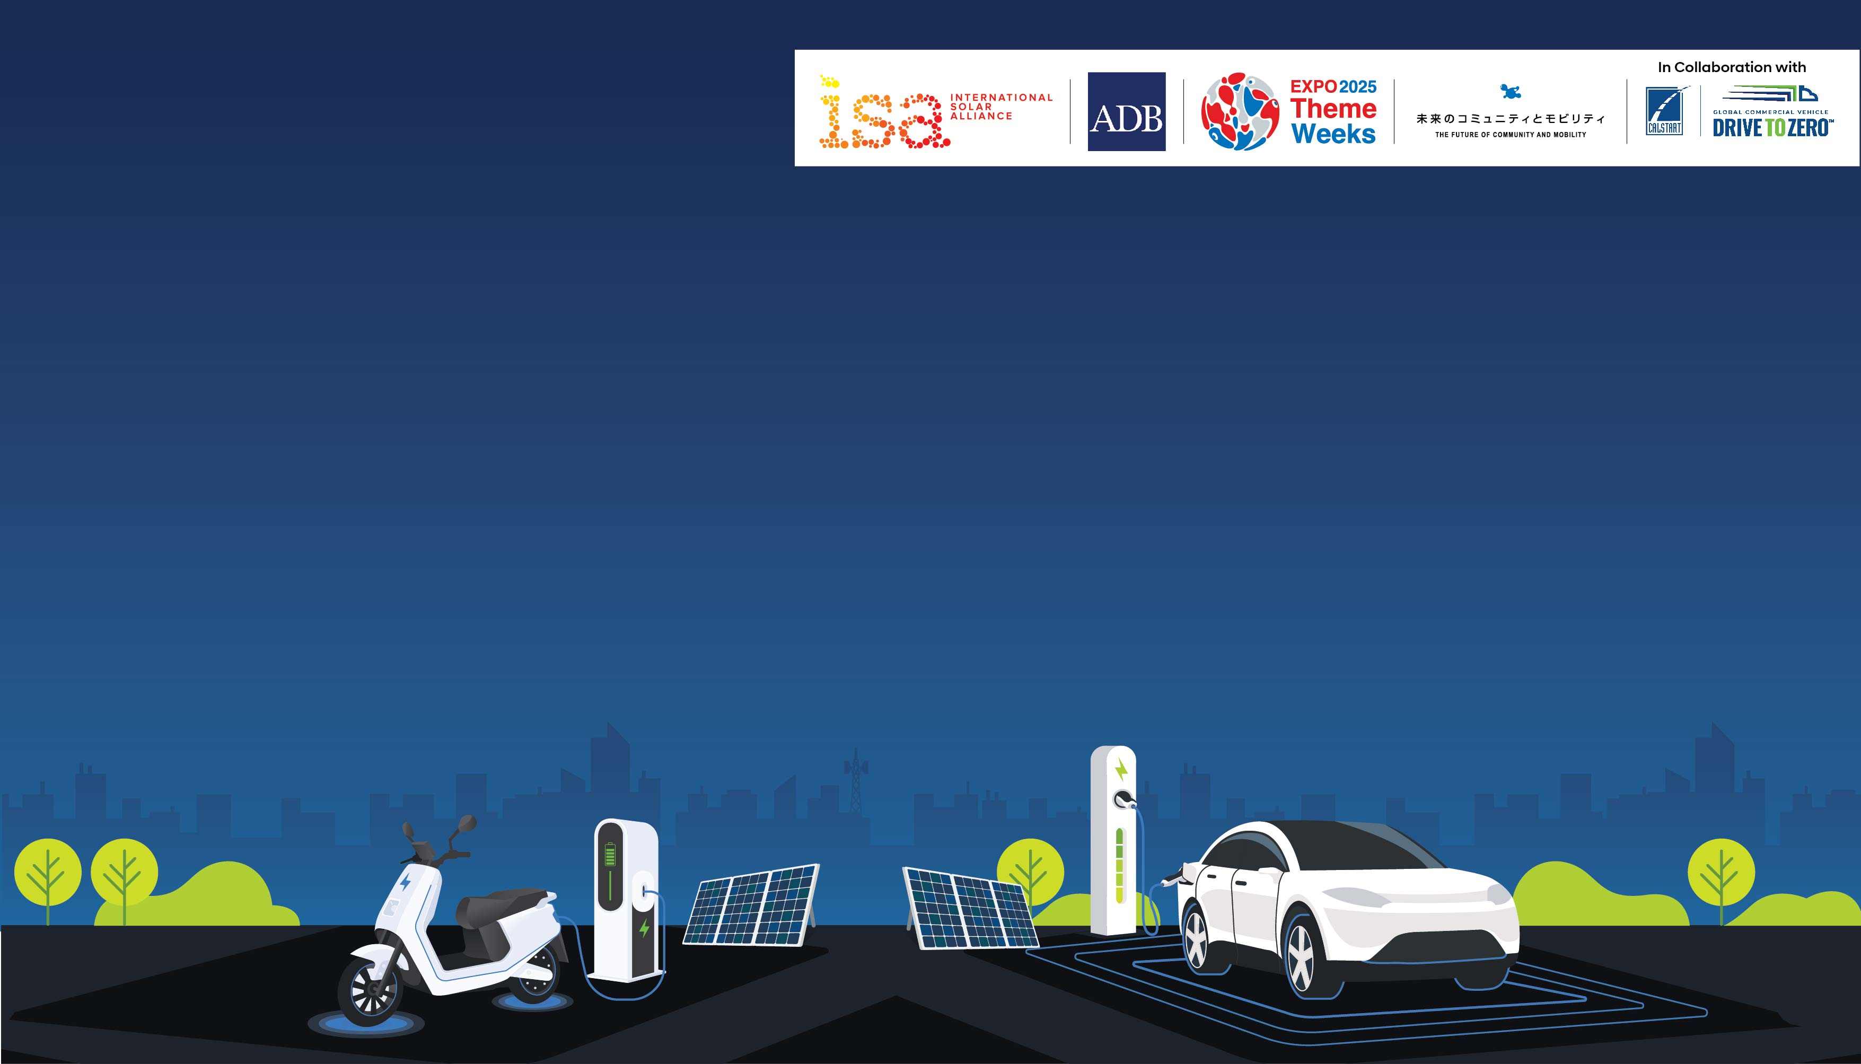

Driving Green: Promoting
Solar EV Deployment
26 May 2025 | 10:00 – 12:00 hrs Japan Standard Time

Slide 2

Social Media Toolkit

Slide 3



#ISA@WorldExpo2025 | #ISA@ThemeWeek
@isolaralliance
/internationalsolaralliance
@internationalsolaralliance

Slide 4
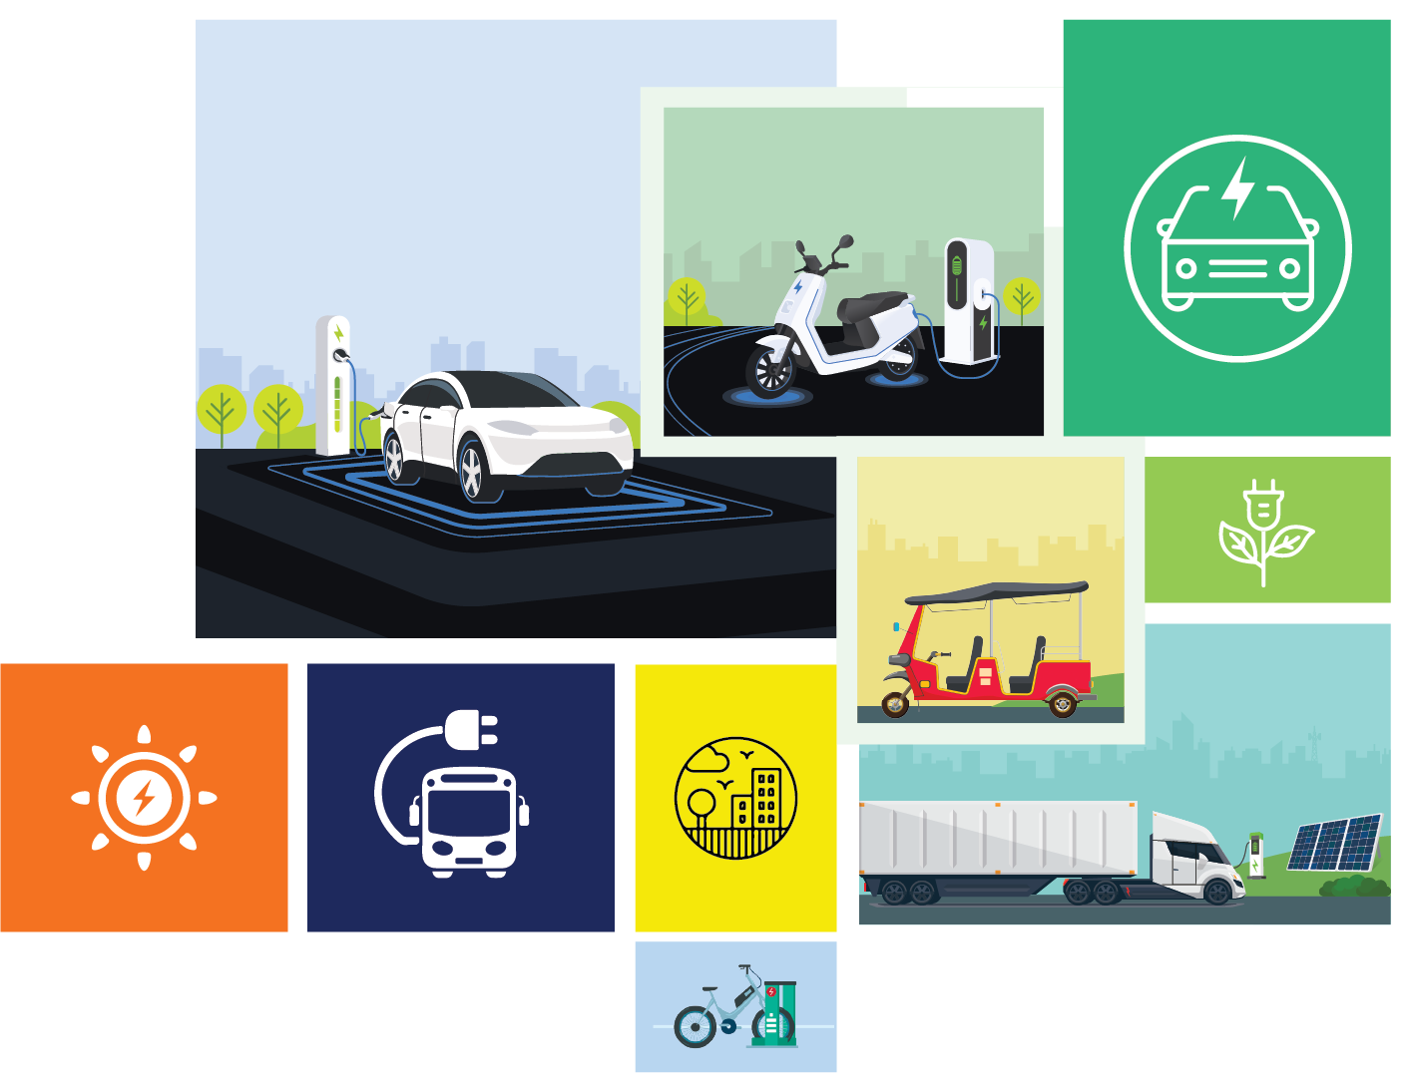
About the Session
ISA, in collaboration with the Asian Development Bank (ADB) and CALSTART, will host a session on “Driving Green: Promoting Solar EV Deployment”
as part of the thematic week on “The Future of Community and Mobility.”
This session will explore opportunities and challenges in building solar-charged e-mobility ecosystems across ISA member countries, with a focus on regional needs, vehicle segments, and real-world case studies. It will also spotlight ISA’s Solar EV Ecosystem Readiness Assessment (SEERA) framework, offering a platform for knowledge sharing and collaboration to advance solar-powered mobility solutions globally.

Slide 5





Slide 6
Sample Posts
Post 1:
Driving Green: Promoting Solar EV Deployment 🌏
Join us on 26 May 2025, 10:00–12:00 JST as the International Solar Alliance (ISA), in collaboration with global partners, convenes a high-level session to explore the opportunities and challenges of building solar-charged e-mobility ecosystems across regions.
With insights from leaders at ADB, World Bank, Toyota, JICA, and more, we’ll discuss:
Technical & policy challenges in solar EVs
Viability of Vehicle Integrated Photovoltaics (VIPV)
Business models & case studies
Launch of ISA’s Solar EV Readiness Assessment for LDCs & SIDS
Let’s shape the future of clean transport together!
👉 Learn more: https://theme-weeks.expo2025.or.jp/en/program/detail/67529e3b5b950.html
#ISA@ThemeWeek #SolarMobility #EVs #EnergyTransition

Slide 7
Sample Posts
Post 2:
Solar-powered mobility is no longer the future — it's the now!
At the Driving Green: Promoting Solar EV Deployment session on 26 May 2025, we bring together voices from Pacific islands to Asia, from private sector innovators like Toyota & Hanergy to global financiers like the World Bank, to chart a roadmap for scaling solar e-mobility globally.
Highlights:
Learn from global case studies
Discover the economic viability of solar Evs
Unveil ISA’s Readiness Assessment covering 64 LDCs & SIDS
Engage in a live panel discussion led by Global Drive to Zero
Be part of the revolution!
Details here: https://theme-weeks.expo2025.or.jp/en/program/detail/67529e3b5b950.html
#ISA@ThemeWeek #SolarEnergy #EVCharging #ClimateAction

Slide 8
